Slide 1

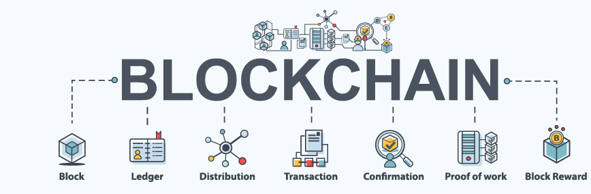
Blockchain
Presentation on
BY SUBHANKAR DAS UNDER GUIDANCE OF BHEMESWARA SHASTRY JANGAM​
ENROLLMENT NO - JK-ENR-JYN-05,
COURSE NAME – MASTER'S IN BLOCKCHAIN DEVELOPMENT,
Batch no – 01,
JETKING JAYANAGAR LEARNING CENTRE, BENGALURU.

Slide 2
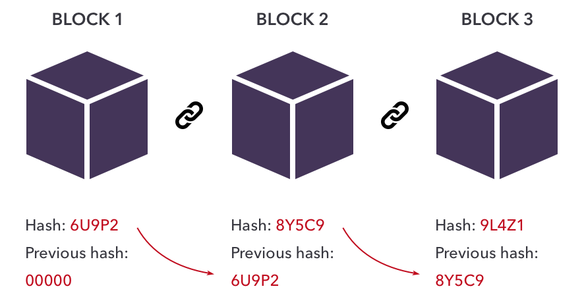
INTRODUCTION
The technology is being adapted into many verticals like Healthcare, Medicines, Insurance, Smart Properties, Automobiles, and even Governments.
Most successful implementation of Blockchain is the Bitcoin - A Peer-to-Peer Electronic Cash System, which incidentally is also the first implementation of blockchain technology.

Slide 3

Before delving into the blockchain, it is important to know why the need for this new technology emerged?

Slide 4
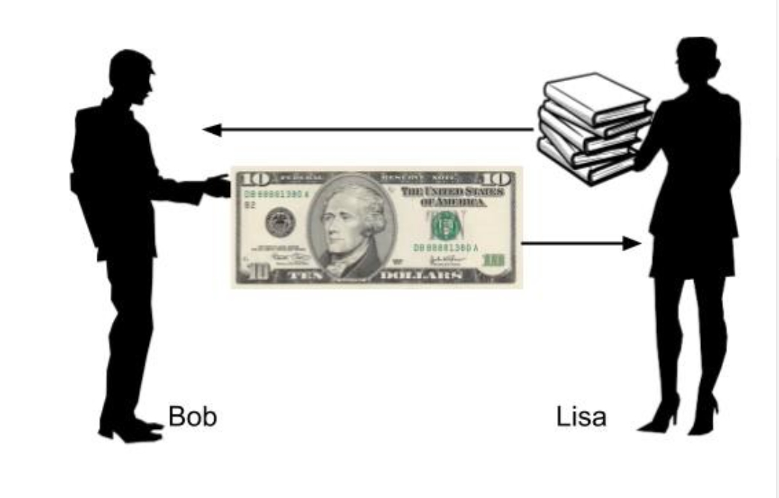
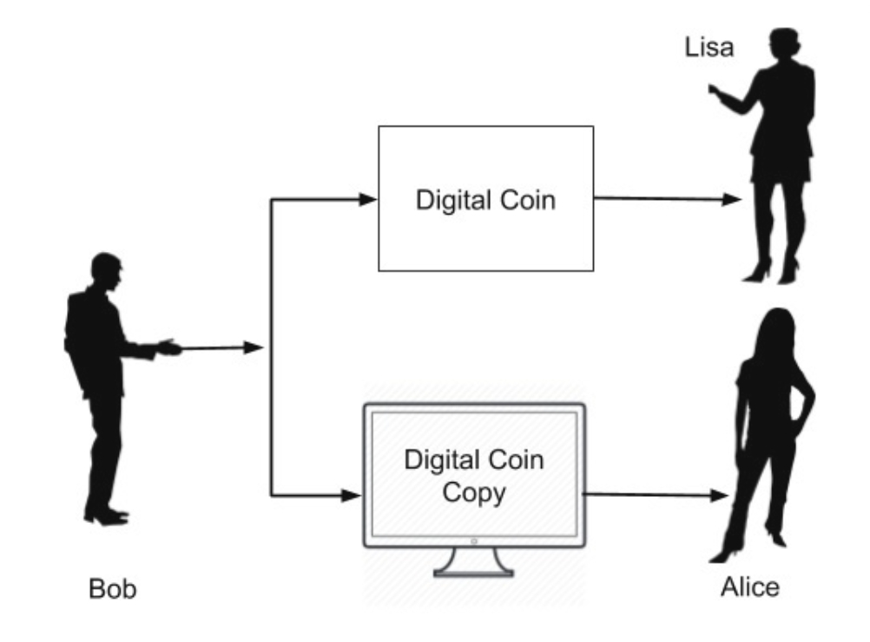
DOUBLE SPENDING
Figure 01
Figure 02

Slide 5
How this problem of DOUBLE SPENDING can be solved ?

Slide 6
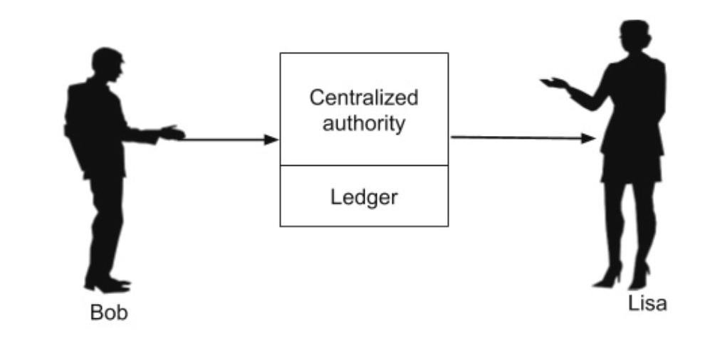
SOLVING DOUBLE SPENDING
The introduction of centralized authority though it solves the double-spending problem, introduces another major issue - the cost of creating and maintaining the centralized authority itself.
As the banks need money for their operations, they start cutting commissions on each currency transaction they do for their clients. This sometimes can become very expensive, especially in overseas transfer of money.​
All the above issues are solved by the introduction of digital currency, called Bitcoin.​
Figure 03

Slide 7
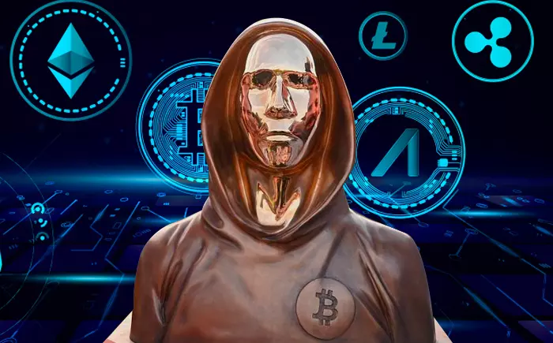
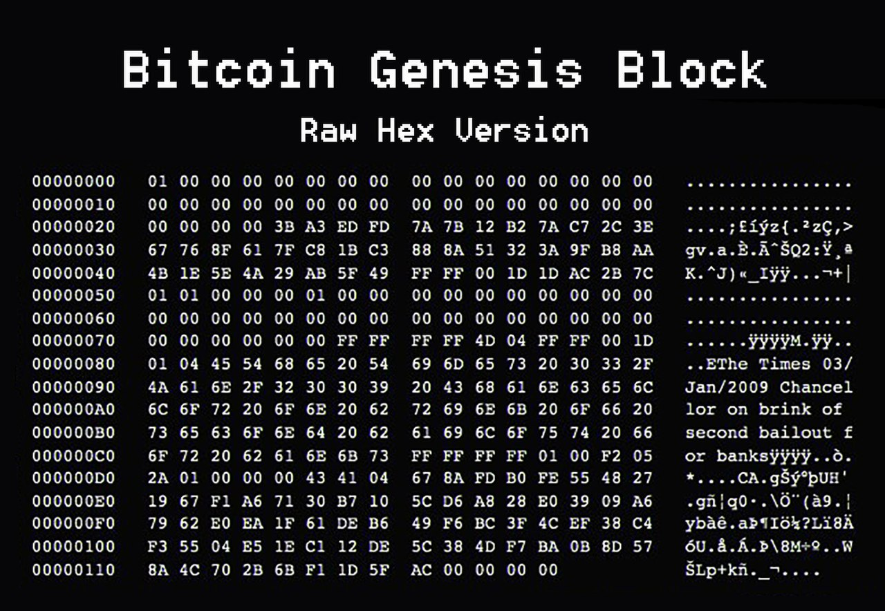
BRIEF HISTORY
Introduced by Satoshi Nakamoto through a research-style white paper entitled Bitcoin: A Peer-to-Peer Electronic Cash System in the year 2008.
The Bitcoin not only solved the double-spending problem, but also offered advantages like The anonymity in the transactions.
Satoshi did transact few coins on this system is totally anonymous to the entire world.
In fact, we do not know whether Satoshi is an individual or a group of people.
Satoshi Nakamoto holds worth about $19.4 billion

Slide 8
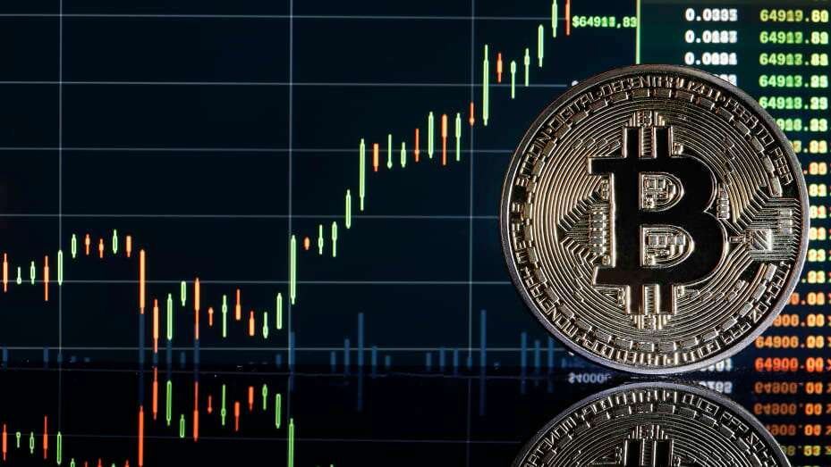

WHAT IS BITCOIN?
Decentralized digital currency, without a central bank or single administrator.
The moment you make such a ledger public, several considerations would come to your mind.
1. This ledger has to be tamper-proof
2. Each entry in the ledger is publicly visible.
3. We will have to figure out how to maintain the anonymity
One single ledger is keeping track of each and every transaction in the world, the size of ledger would be another great concern.

Slide 9
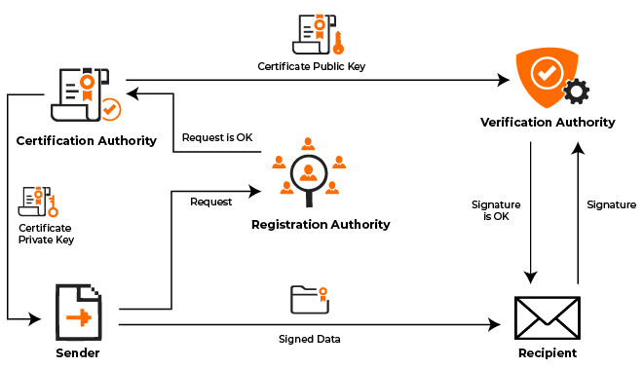
PUBLIC KEY CRYPTOGRAPHY
Public Key Cryptography or PKI(Public Key Infrastructure) is also known as asymmetric cryptography.
It uses two pairs of keys - Public and Private. A key is a some long binary number.
1. The public key is distributed worldwide and is truly public as its name suggests.
2. The private key is to be strictly held private and one should never lose it.
If you ever lose the private key to your Bitcoin wallet, the
entire contents of your wallets would be instantly vulnerable .
The PKI accomplices two functions :
1. Authentication
2. Message privacy

Slide 10
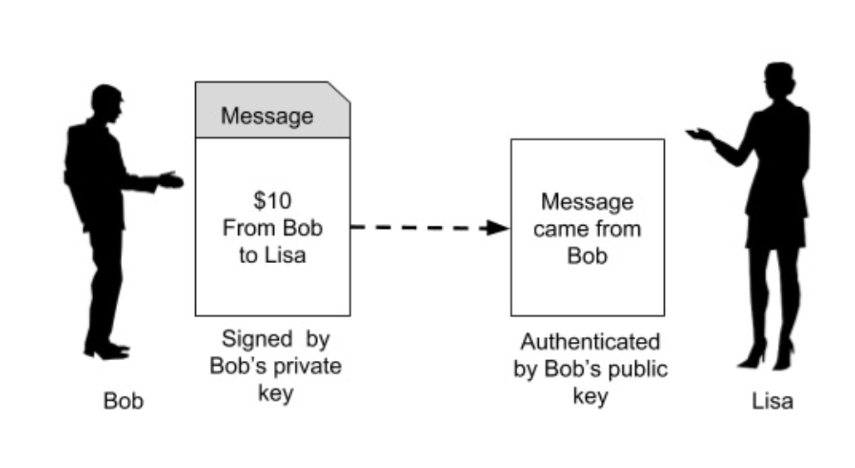
AUTHENTICATION
When the two parties exchange messages, it is important to establish a trust between the sender and the receiver. Especially, the receiver must trust the source of message. ​
Figure 04

Slide 11
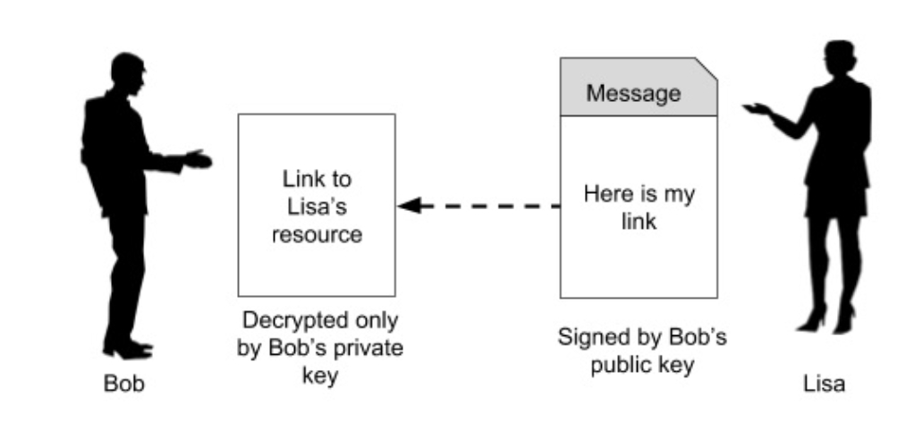
MESSAGE PRIVACY
Having seen both the features, Authentication and Message Privacy, implied by PKI, let us move ahead to see how Bitcoin makes use of PKI to secure the public ledger that I mentioned in the slide “What is Bitcoin?”.
For your knowledge − The most popular PKI algorithms are RSA(Rivest–Shamir–Adleman) and ECDSA(Elliptic Curve Digital Signature Algorithm).
Figure 05

Slide 12
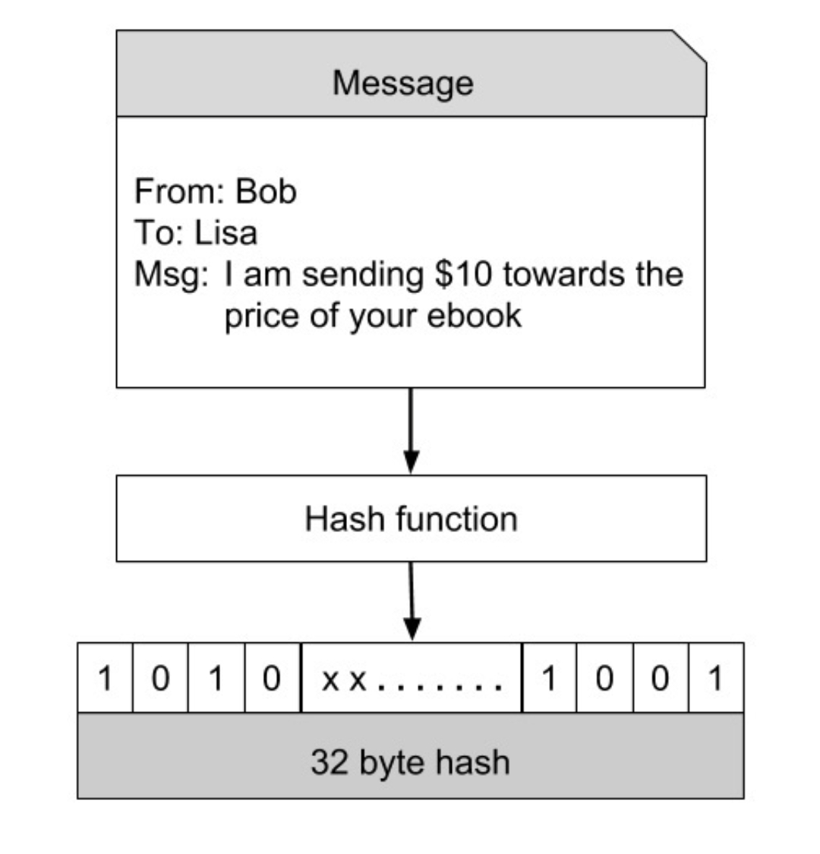
HASHING
One of the most important function in PKI is the hashing function.
A hash function maps the data of any arbitrary size to data of fixed size.
Bitcoin uses SHA-256(Secure Hash Algorithm-256 bits number) hash function that produces a hash (output) of size 256 bits (32 bytes). This is illustrated in image (Figure 06)
Figure 06

Slide 13
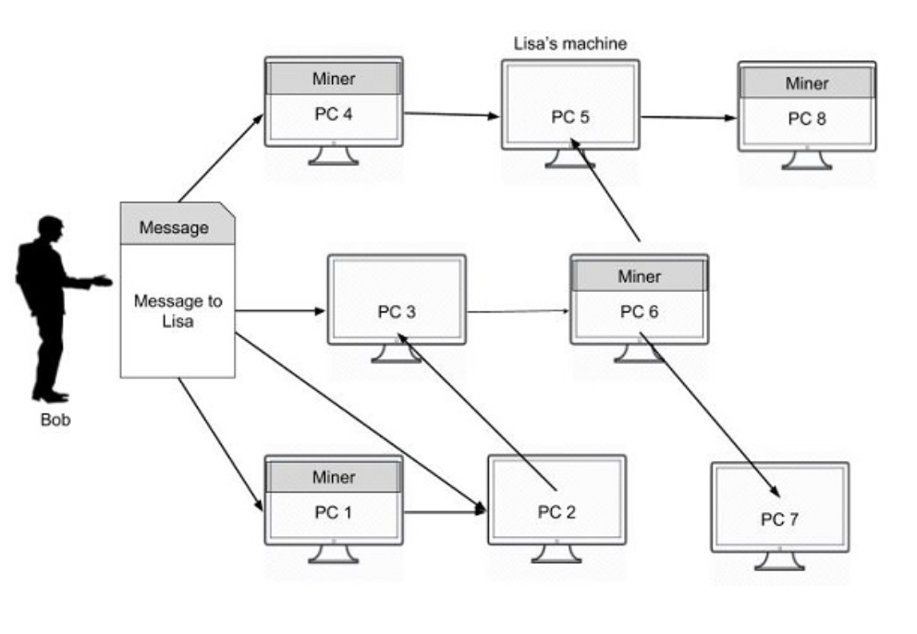
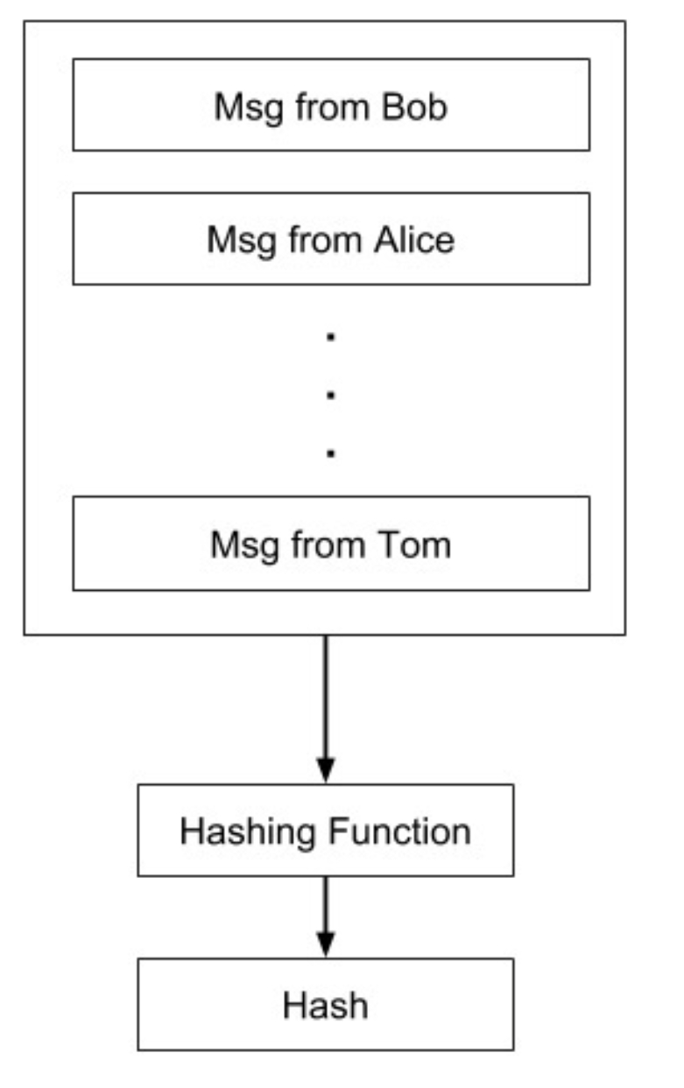
BITCOIN MINING
The message goes to all the connected nodes (machines). Some of the nodes in the diagram are marked as miners.
These are the machines which run a piece of software for mining the bitcoin message. I will now explain you what this mining means.
Figure 07
Mining Process
As the entire network is widely distributed, every miner in the network is expected to receive multiple messages from multiple vendors at any given period of time. What the miner does is he combines these messages in a single block. This is illustrated in image −(Figure 08)
After a block of messages is formed, the miner creates a hash on the block using the hashing function described earlier.
Figure 08

Slide 14
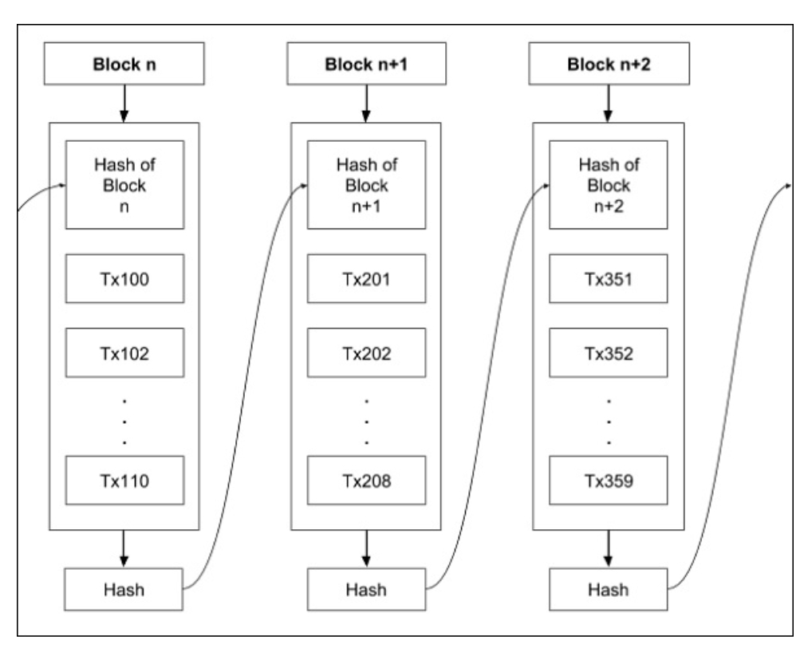
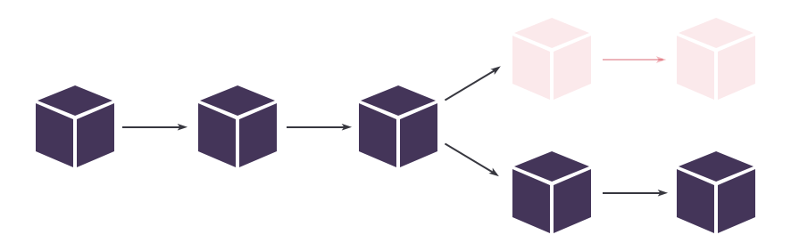
CHAINING BLOCKS
The blocks created by various miners are chained together to form what is known as a truly distributed public ledger.
Each block in the chain contains multiple messages (transactions) as seen earlier.
A block in the chain may come from any miner. While creating the chain of blocks, we observe the rule that hash of the previous block is added to the current block.

Slide 15
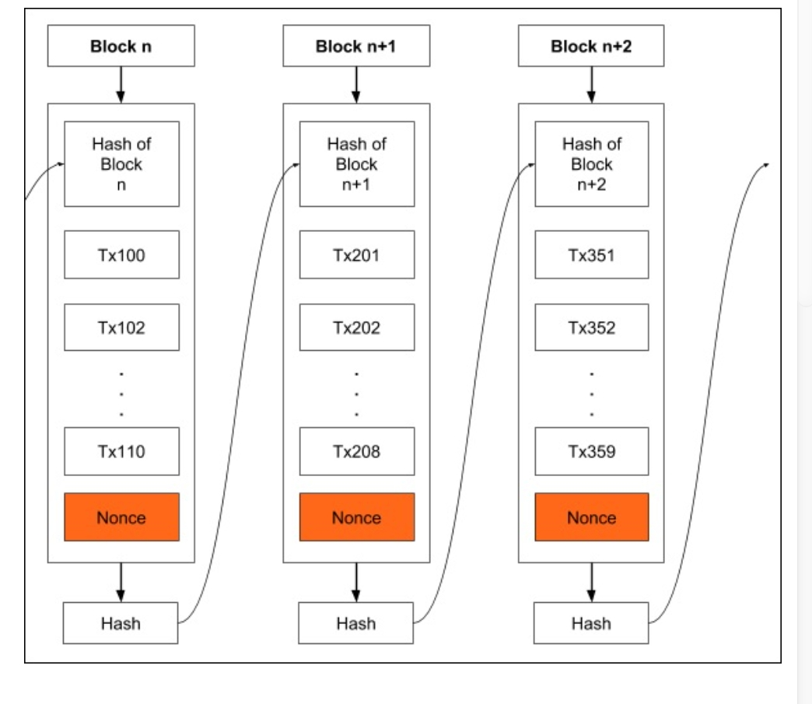
PROOF OF WORK
As all transactions are time stamped, we need to implement a distributed timestamp server on a peer-to-peer network.
This requires some additional implementation and that is the Proof-of-Work that I will describe now. To each block, we now add one more item called Nonce as shown in the figure(Figure 09)
Nonce is a number such that the block’s hash meets a certain criterion. This criterion could be that the generated hash must have its leading four digits to be zero.
Thus, the generated hash would look like 000010101010xxx.
Note that the hash generation works at random and is beyond your control - that is you cannot force the hash function to generate a certain hash.
Figure 09

Slide 16
NETWORK AND MINING
I will now summarize the steps described above; this is what happens in the network −
Anybody who wants to obtain services from the third party who has advertised on the network first creates a transaction.
Over a given period of time, there could be many senders (buyers) and receivers (sellers) creating such transactions.
All transactions are broadcast on the network to all nodes.
Each node assembles the new transactions into a block.
The node now works on finding the proof-of-work for its assembled block.
When the node finds a proof-of-work, it broadcasts the assembled block on the network.
The nodes that receive the new block will accept it only after verifying that all transactions in the block are valid and not already spent.
If the block is accepted as valid, the node which is working on its own new block will have to re-assemble the transactions in its block ensuring that the transact.

Slide 17
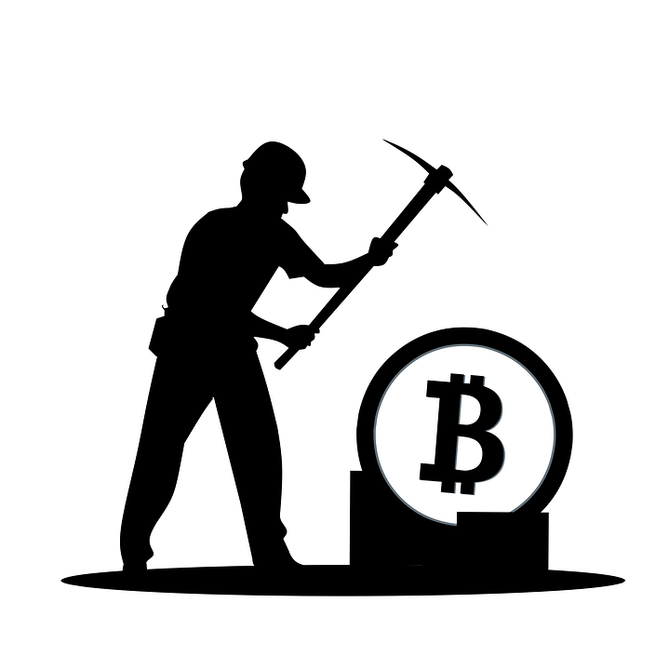
INCENTIVES TO MINERS
A miner may be flooded with many transactions at any given period of time. The maximum size for a block is pre-defined in the system necessitating that only a certain number of transactions be included in the block.
The number of transactions in the block is determined by the pre-defined block size and the average length of each block.
An important tip here is that the sender should not include too much information in its message.
A sender generally will also add a transaction fee in terms of a certain
number of bitcoins.

Slide 18
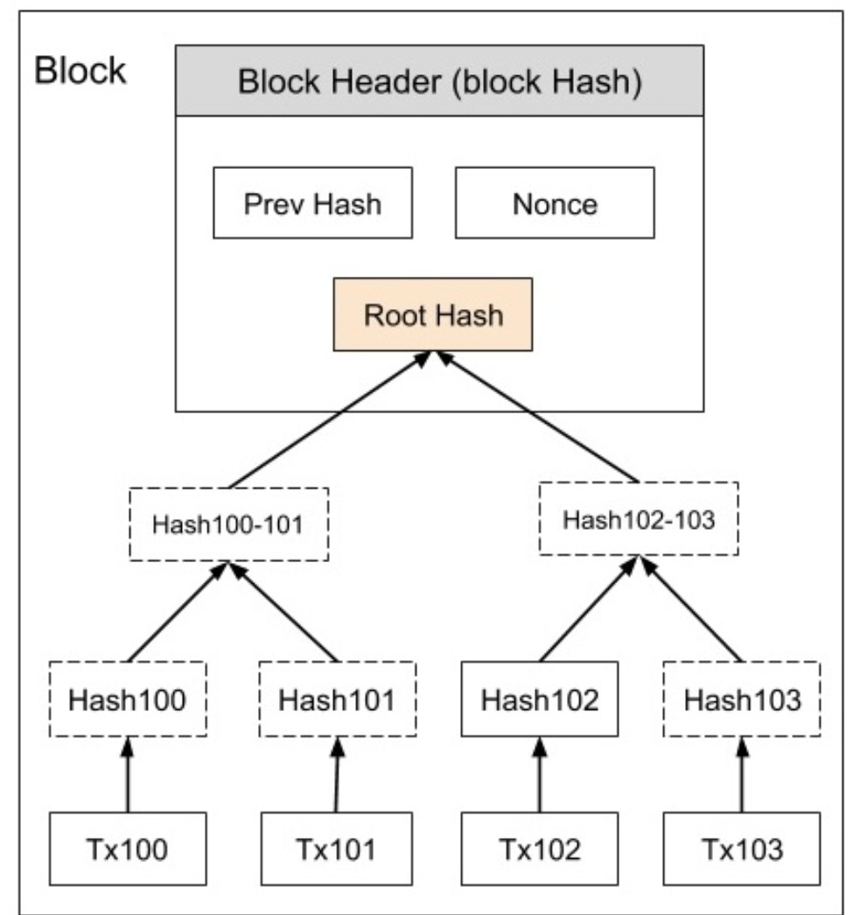
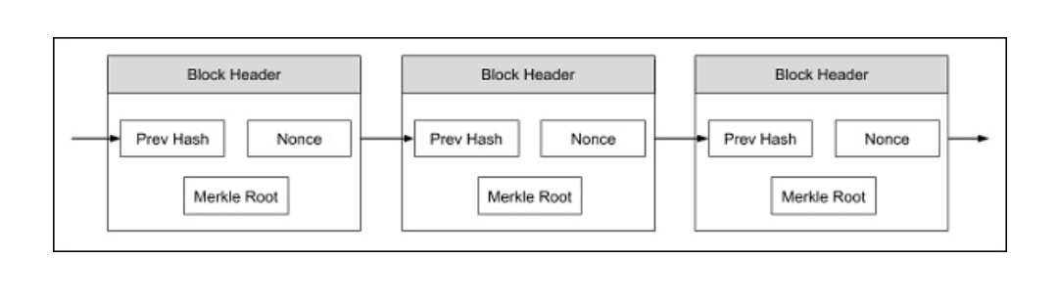
MERKLE TREE
Figure 11
Figure 10

Slide 19
How a receiver verifies the payment without having the ability to trace a received coin right to its origin ?

Slide 20
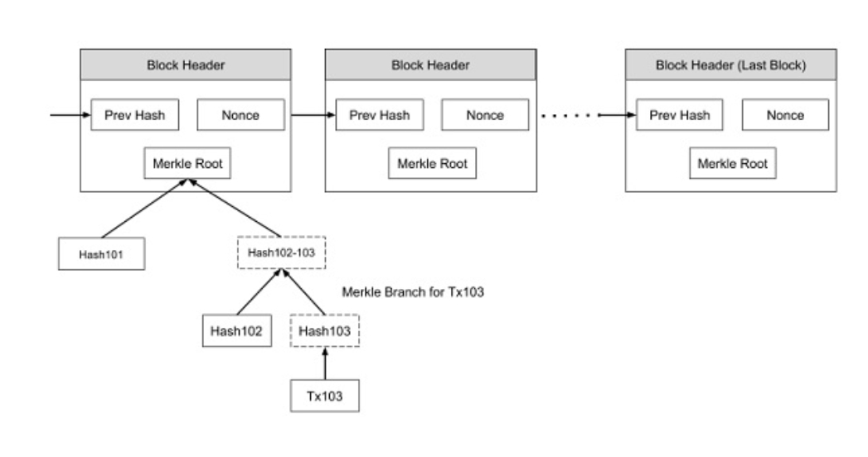
Consider a case whereby as a vendor you may like to verify a certain payment made in the past.
You can now search backwards in your copy of the blockchain until you find a block in which the desired transaction is timestamped in.
Now, request the Merkle tree of the selected block and you will have the transaction that you are looking for. This is illustrated in below Figure (Figure 12)
Here, we assume that you are looking for Tx103. Though you may not be able to see the contents of Tx103, you know that this has been accepted by the block to which it belongs and all subsequent blocks in the chain.
PAYMENT VERIFICATION
Figure 12

Slide 21
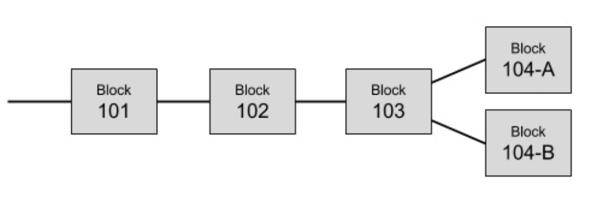
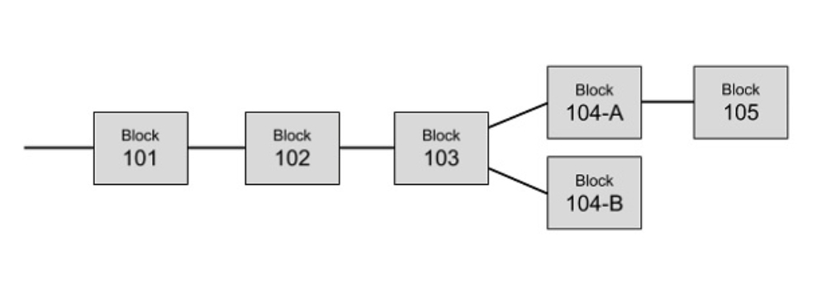
RESOLVING CONFLICTS
As we have seen the Bitcoin network contains several miners. It is possible, that the two different miners solve the Proof-of-Work at the same time and thus add their blocks to the last known block in the chain. This is illustrated in image (Figure 13)
In Bitcoin architecture, the longest branch always wins and the shorter ones are purged. So the Block 104-B has to be purged. Before purging this block, all transactions in this block will be returned to the transaction pool so that they are mined and added to some future block.
Figure 13
Figure 14

Slide 22


PRIVACY
As the ledger which is recording all the bitcoin transactions is made truly public, the privacy is at stake. The traditional banking system is able to maintain this kind of privacy by keeping its records confidential.
Note that we said that the sender of a bitcoin needs to know whom to pay. So he asks for the public key of the vendor to which he desires to make the payment. This public key can be anonymous.
To achieve a higher degree of privacy, for every transaction, you may generate a new private/public key for each transaction so that multiple transactions made by you cannot be grouped together by a third party.
Any online internet based system is vulnerable to abuses.

Slide 23
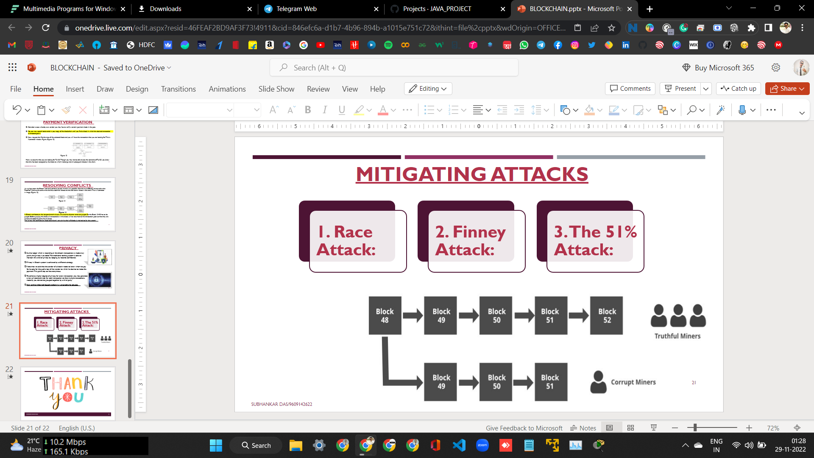
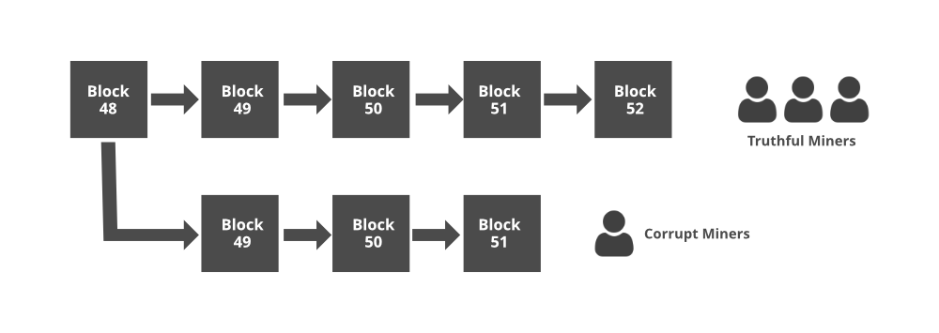
MITIGATING ATTACKS

Slide 24


